Slide 1
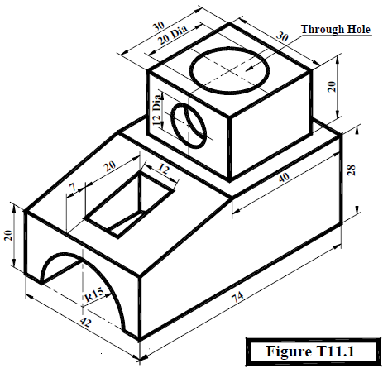

7
20
12
R=10
R=6
30
For Vertical section:
Note : The gray color represents the hatching
R=15

